Slide 1



The Coupling of Two Processes to Create Algae Biofuel
1/13
By: Jessica Peebles
Mentor: Dr. Kimberly Ogden
Department of Chemical and Environmental Engineering
Saturday, April 14th, 2016
University of Arizona

Slide 2
Improvements to the environment
2/13
One solution to two environmental problems:
  Reduces greenhouse gas emissions
  Offers a viable alternative fuel
    Does not utilize corn feedstock needed for human dietary consumption
    Cleaner fuel than petroleum/gasoline
    Does not require deforestation like biofuel from wood biomass
  Solves the water consumption issue
    Power plant process water must be treated prior to disposal

Slide 3
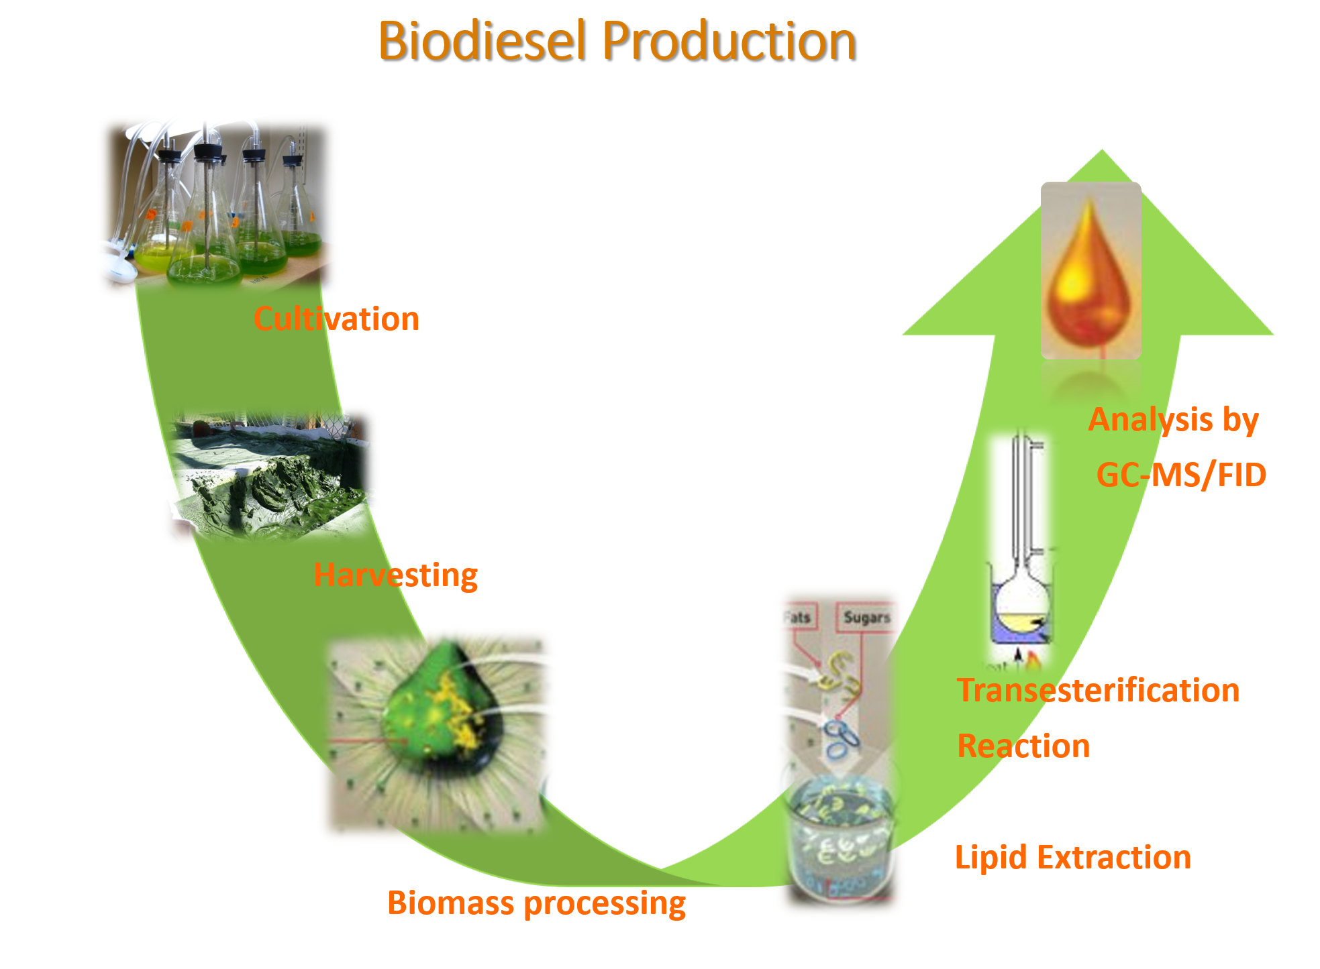
3/13

Slide 4
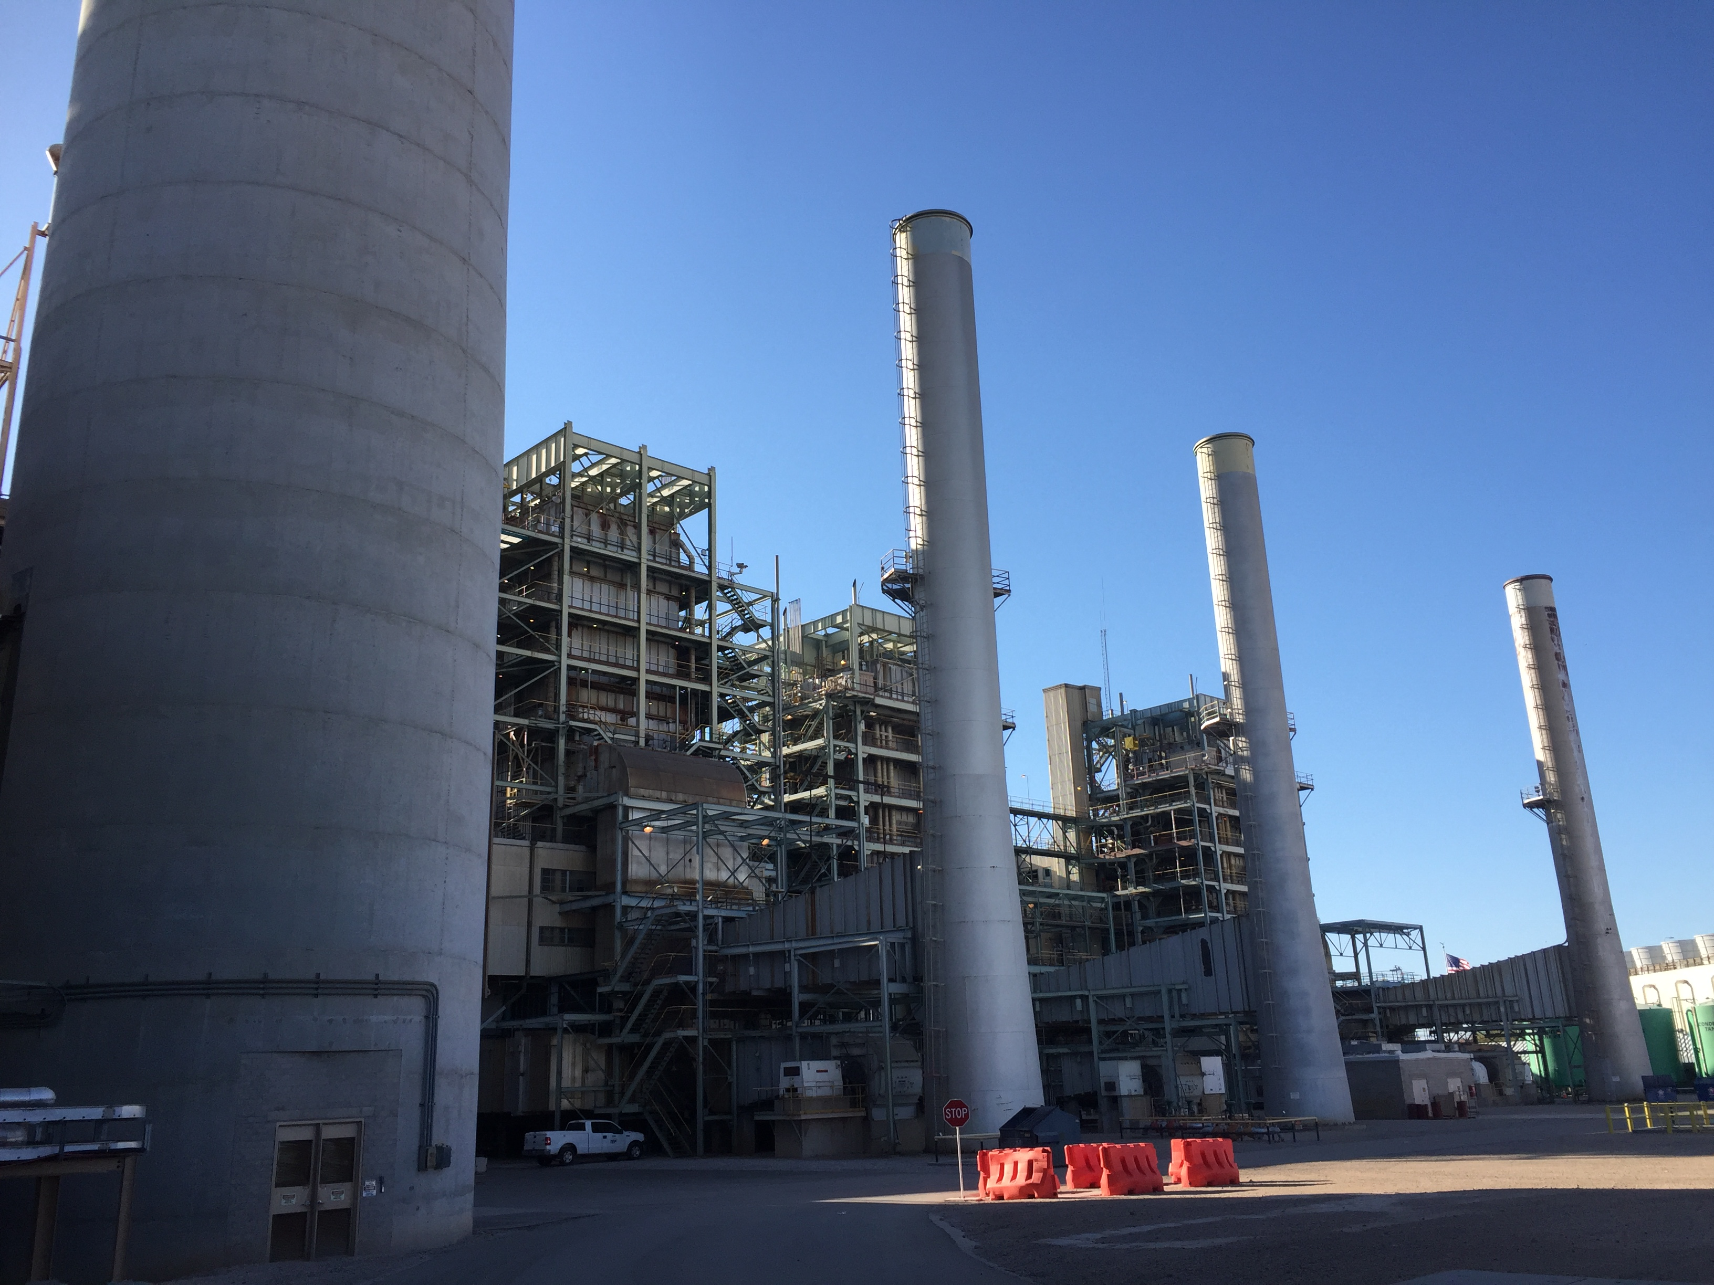
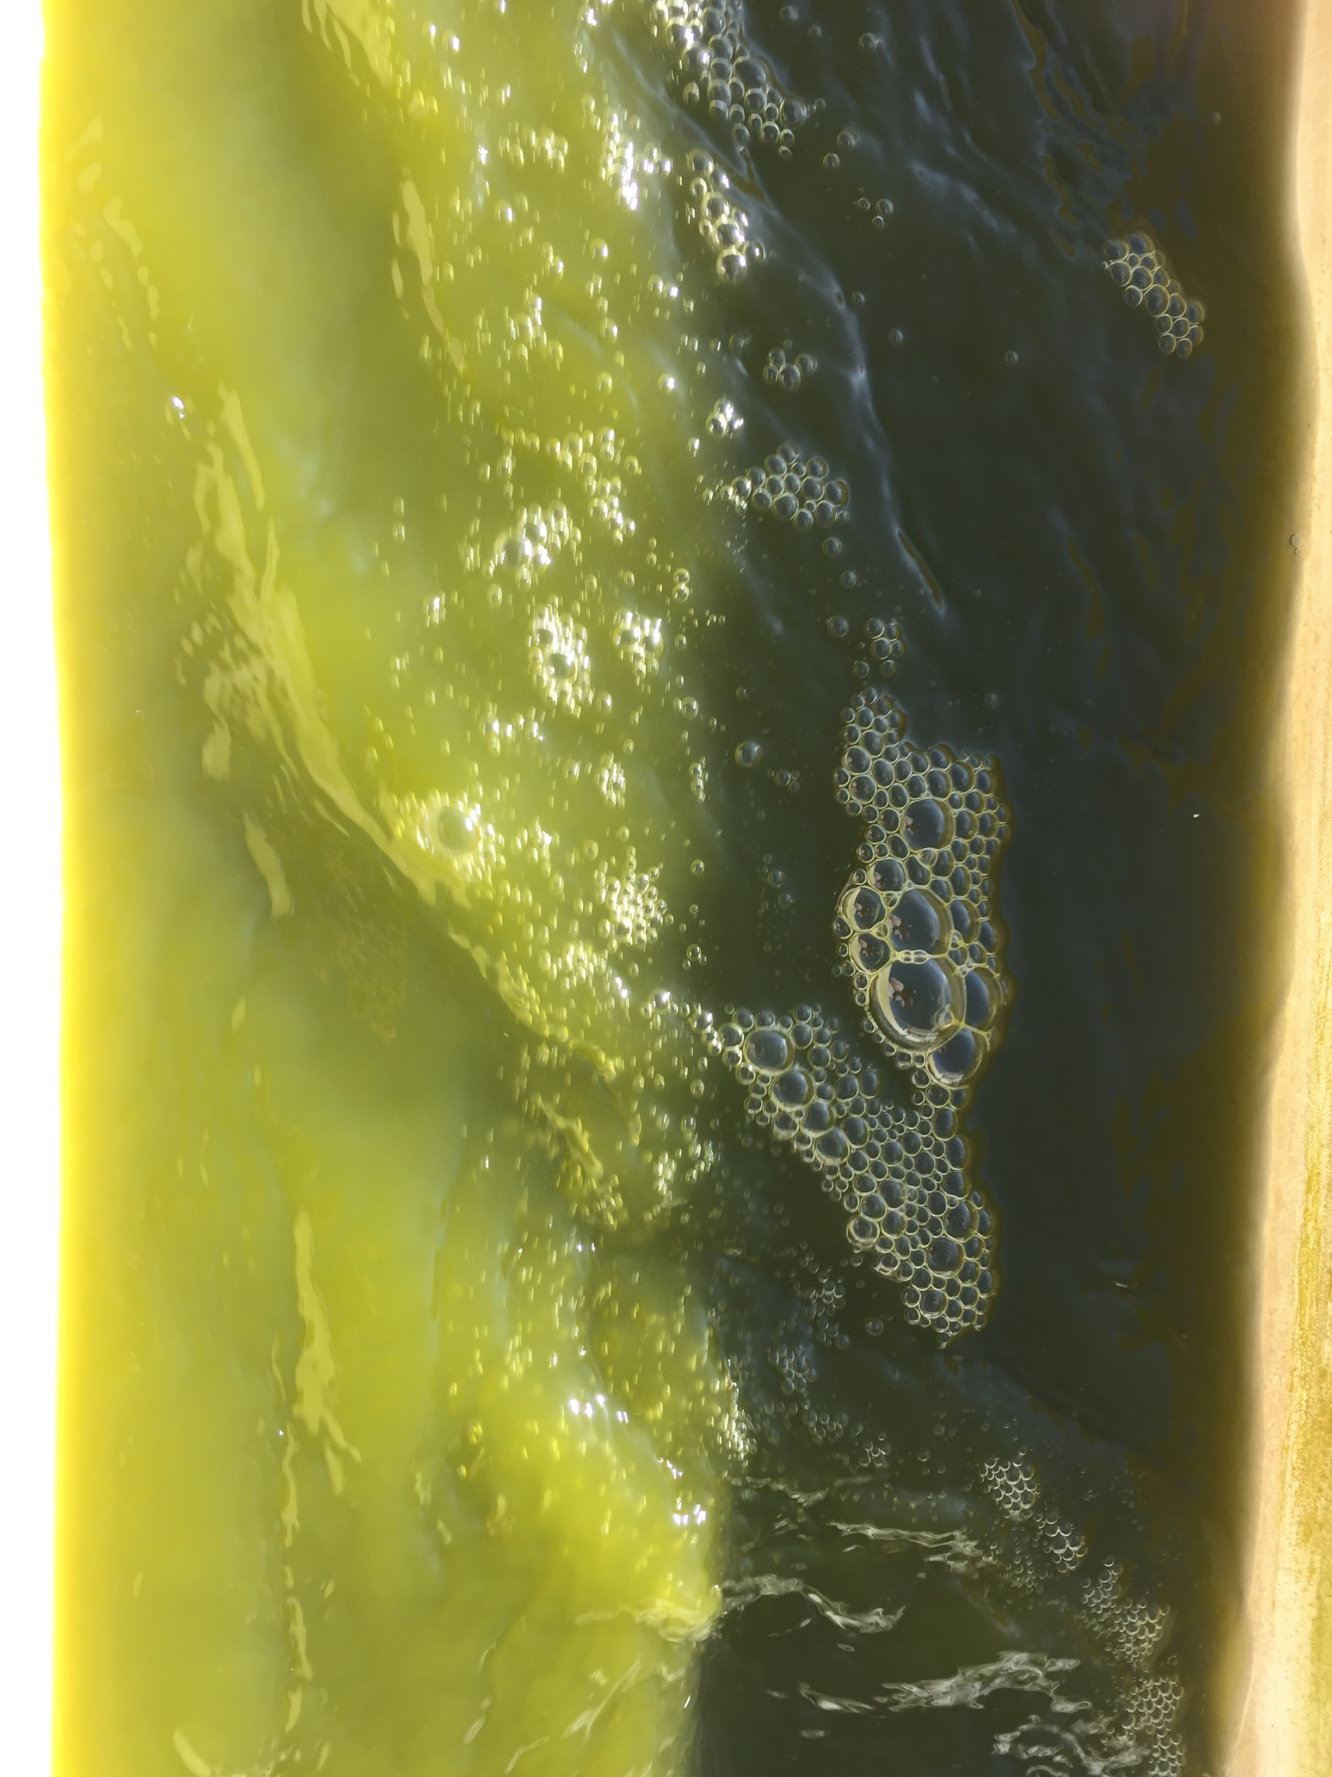
Process 1: Mitigation of CO2
4/13
The algae recycle the CO2 normally emitted into the atmosphere (flue gas), and feeds on it to create biomass
The lipids created by the algae are valuable for a efficient burning biodiesel
The CO2 also controls the pH of the algae’s growth environment

Slide 5
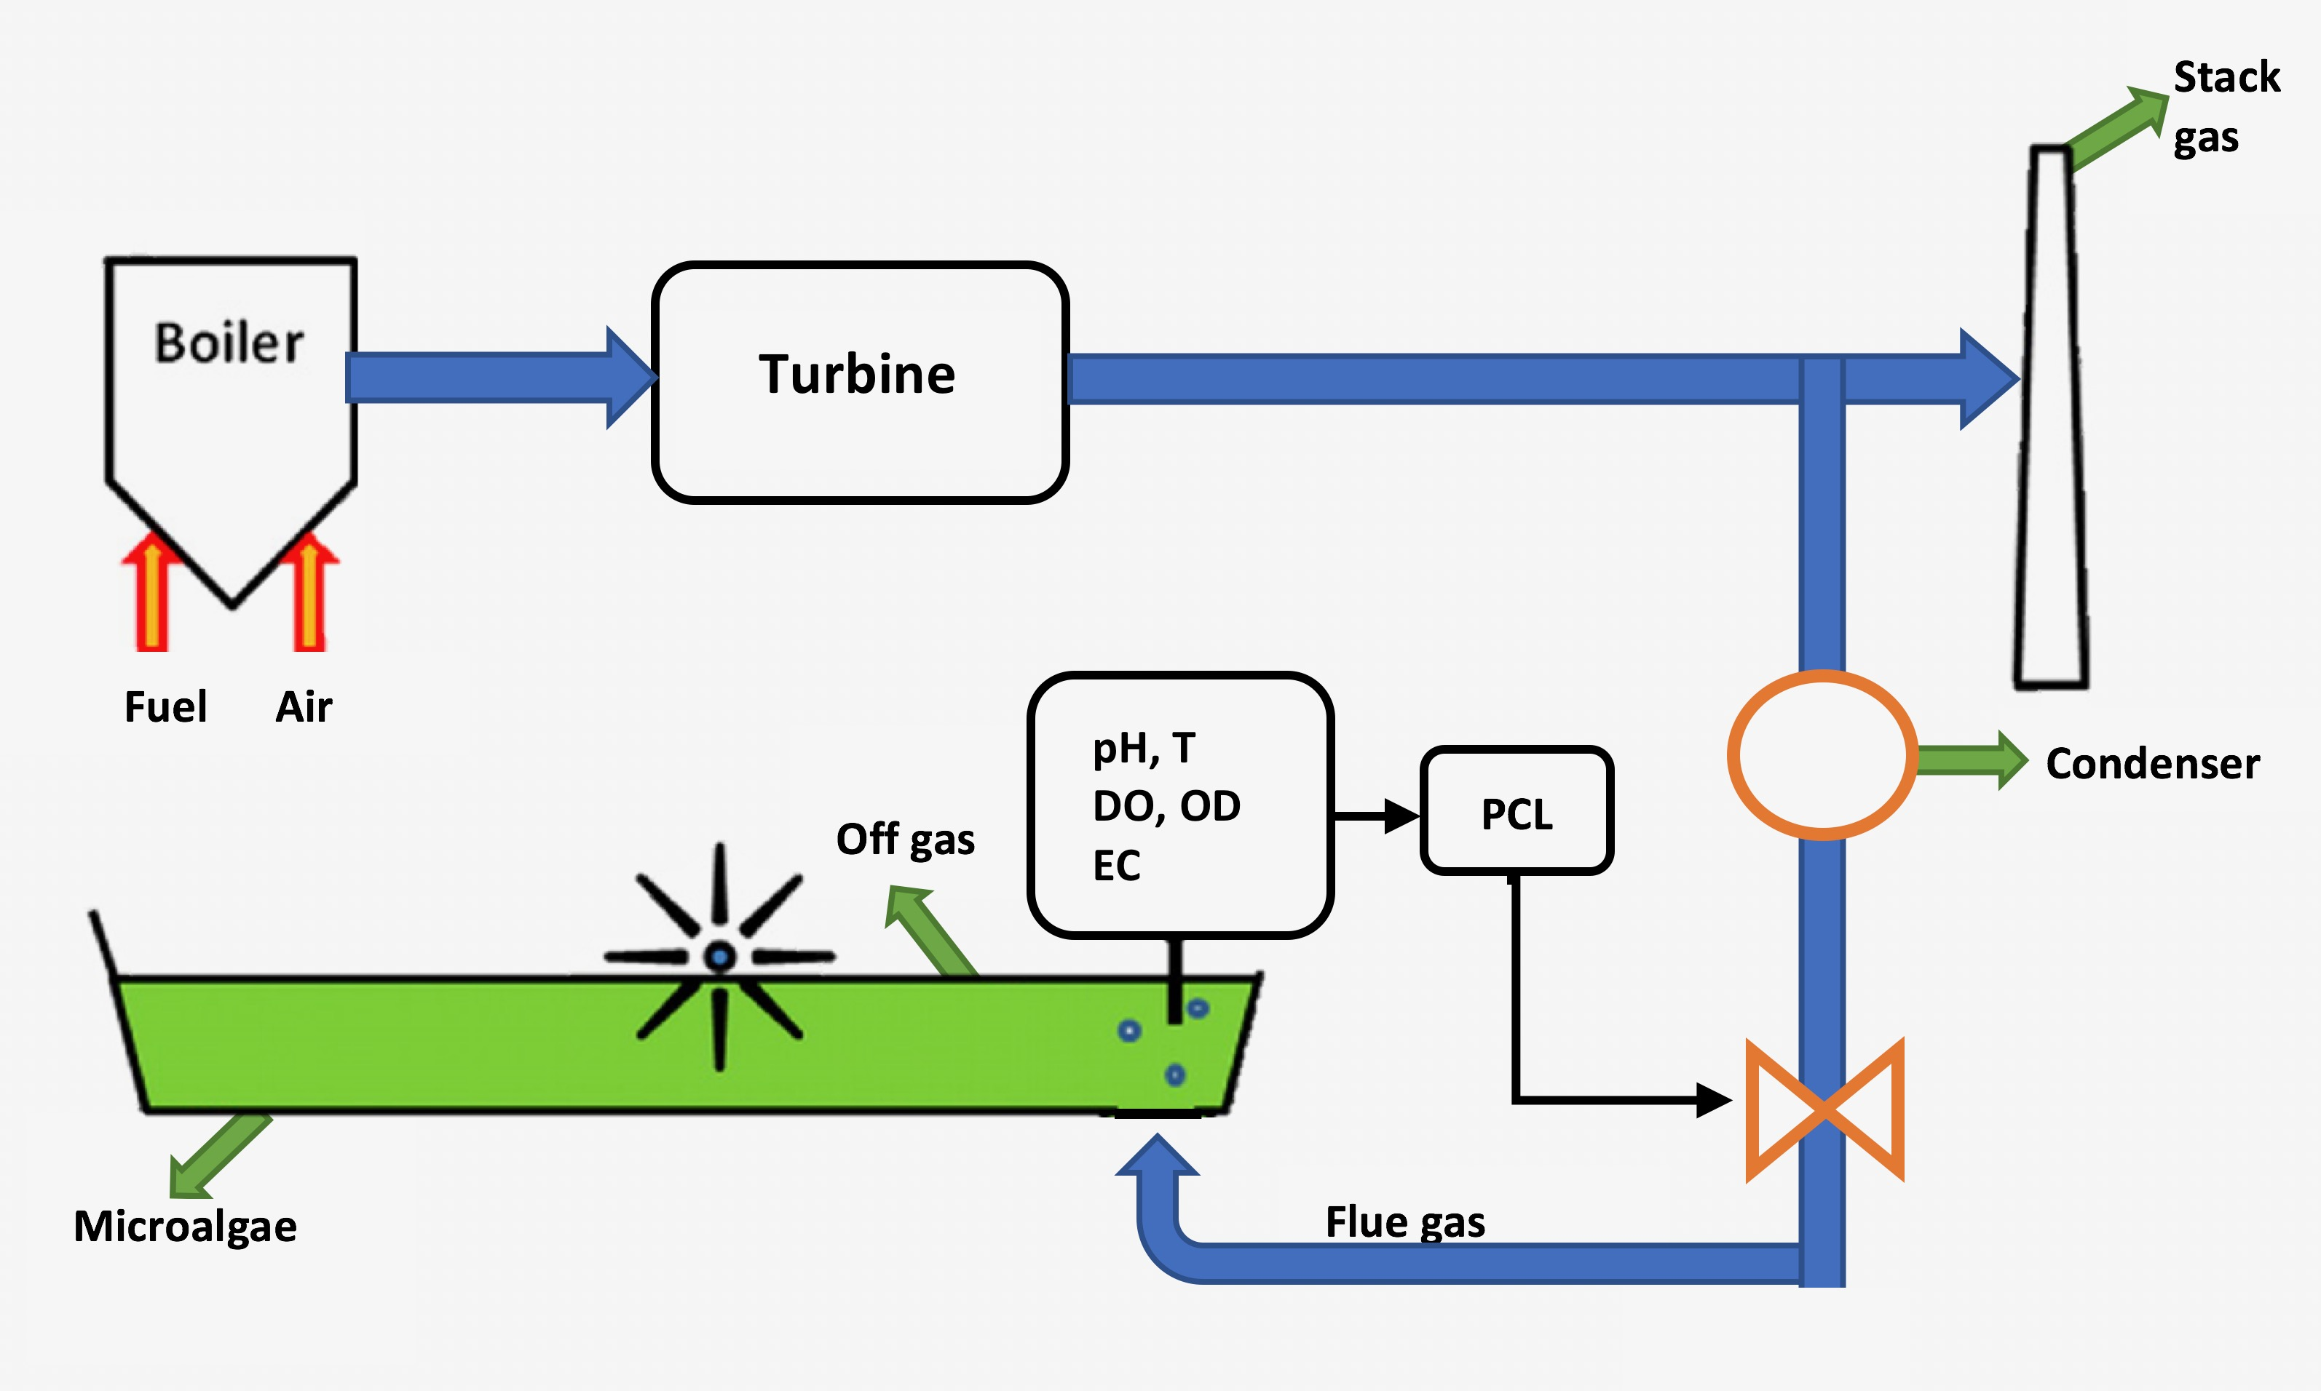
6/13

Slide 6
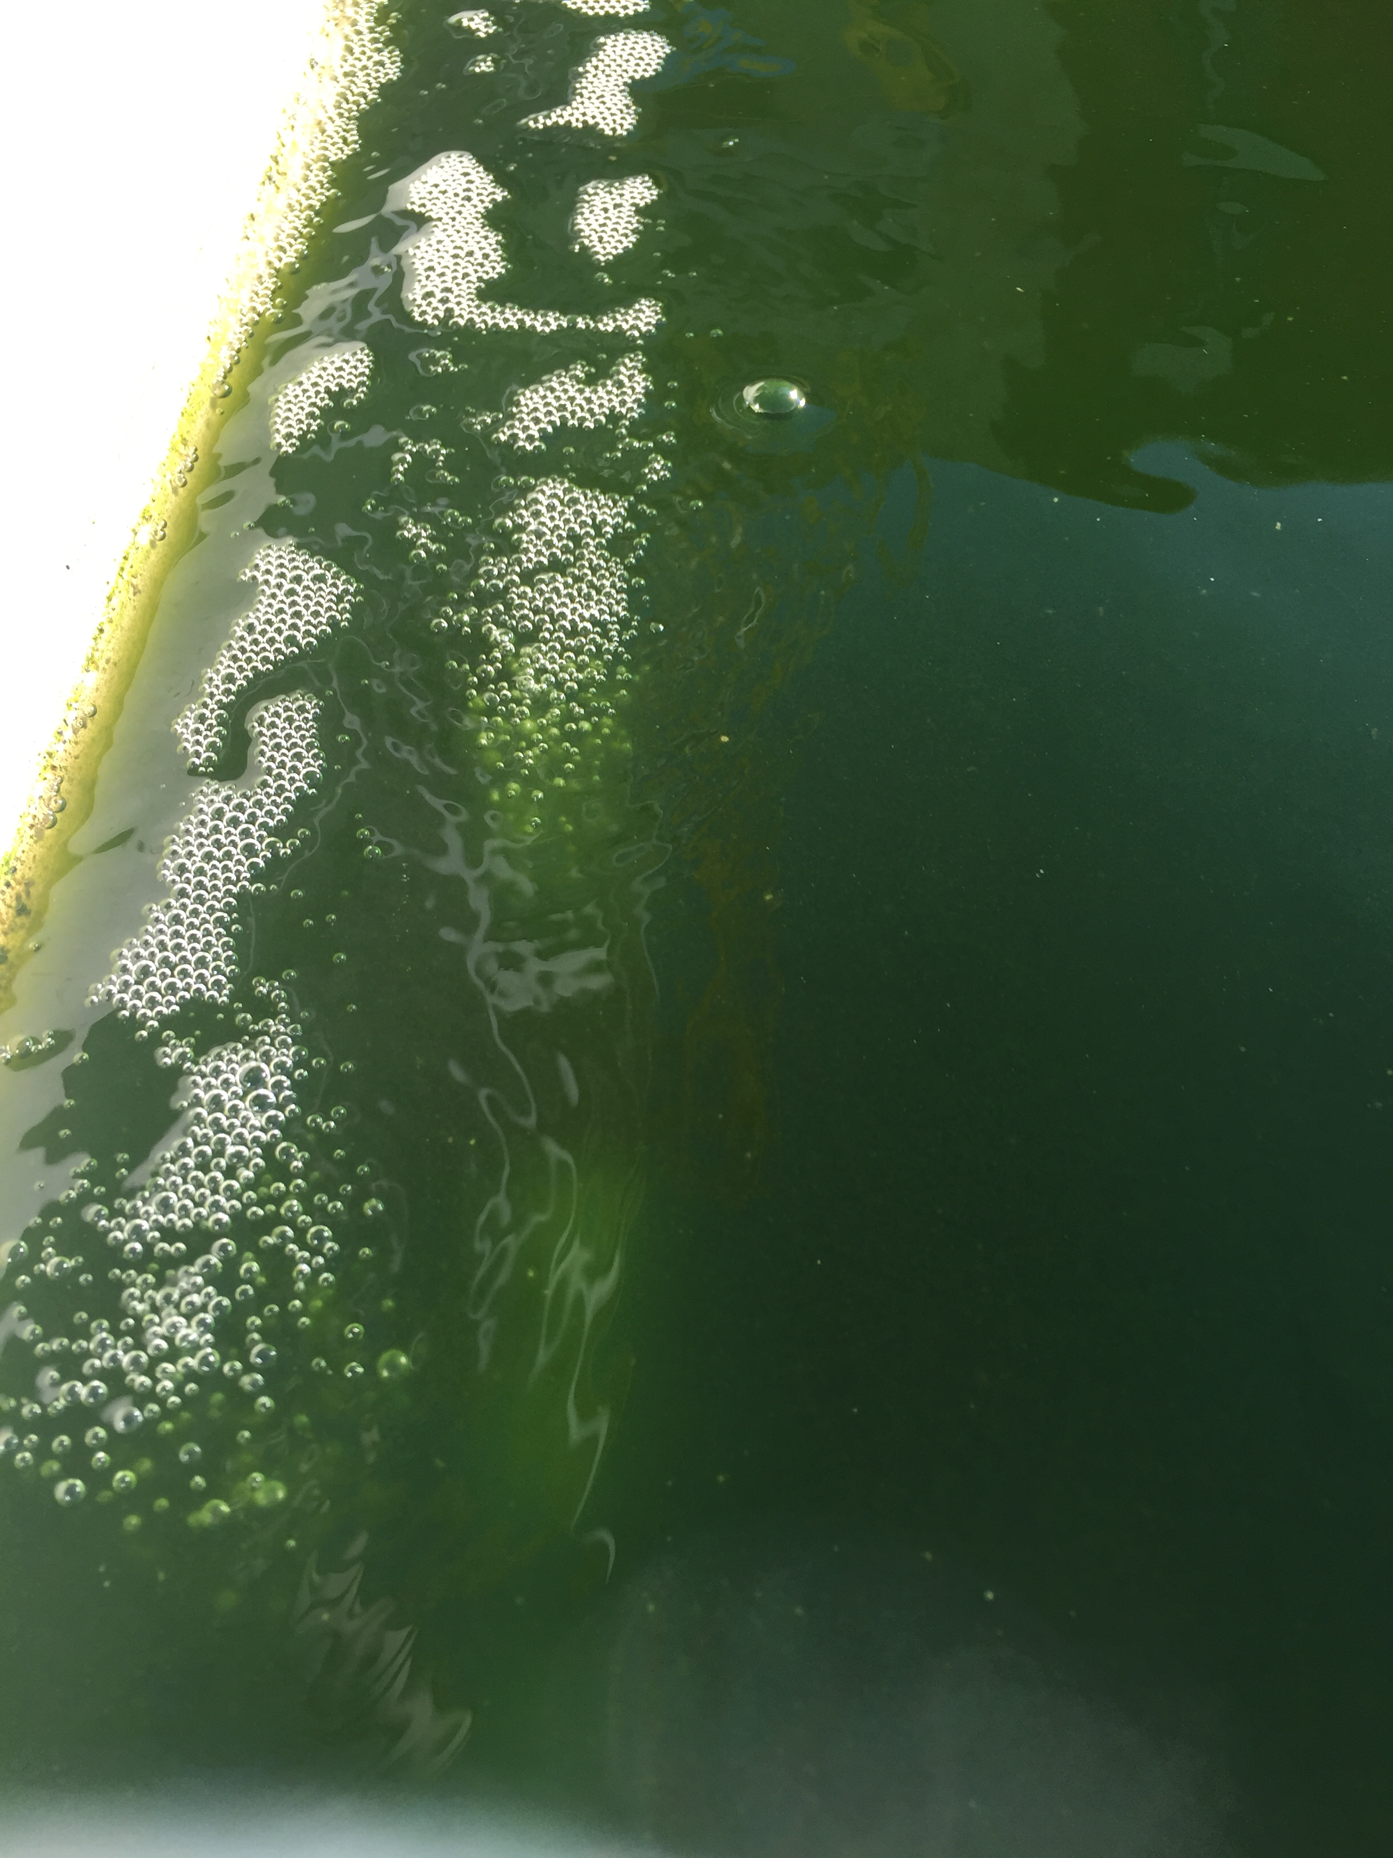

Slide 7
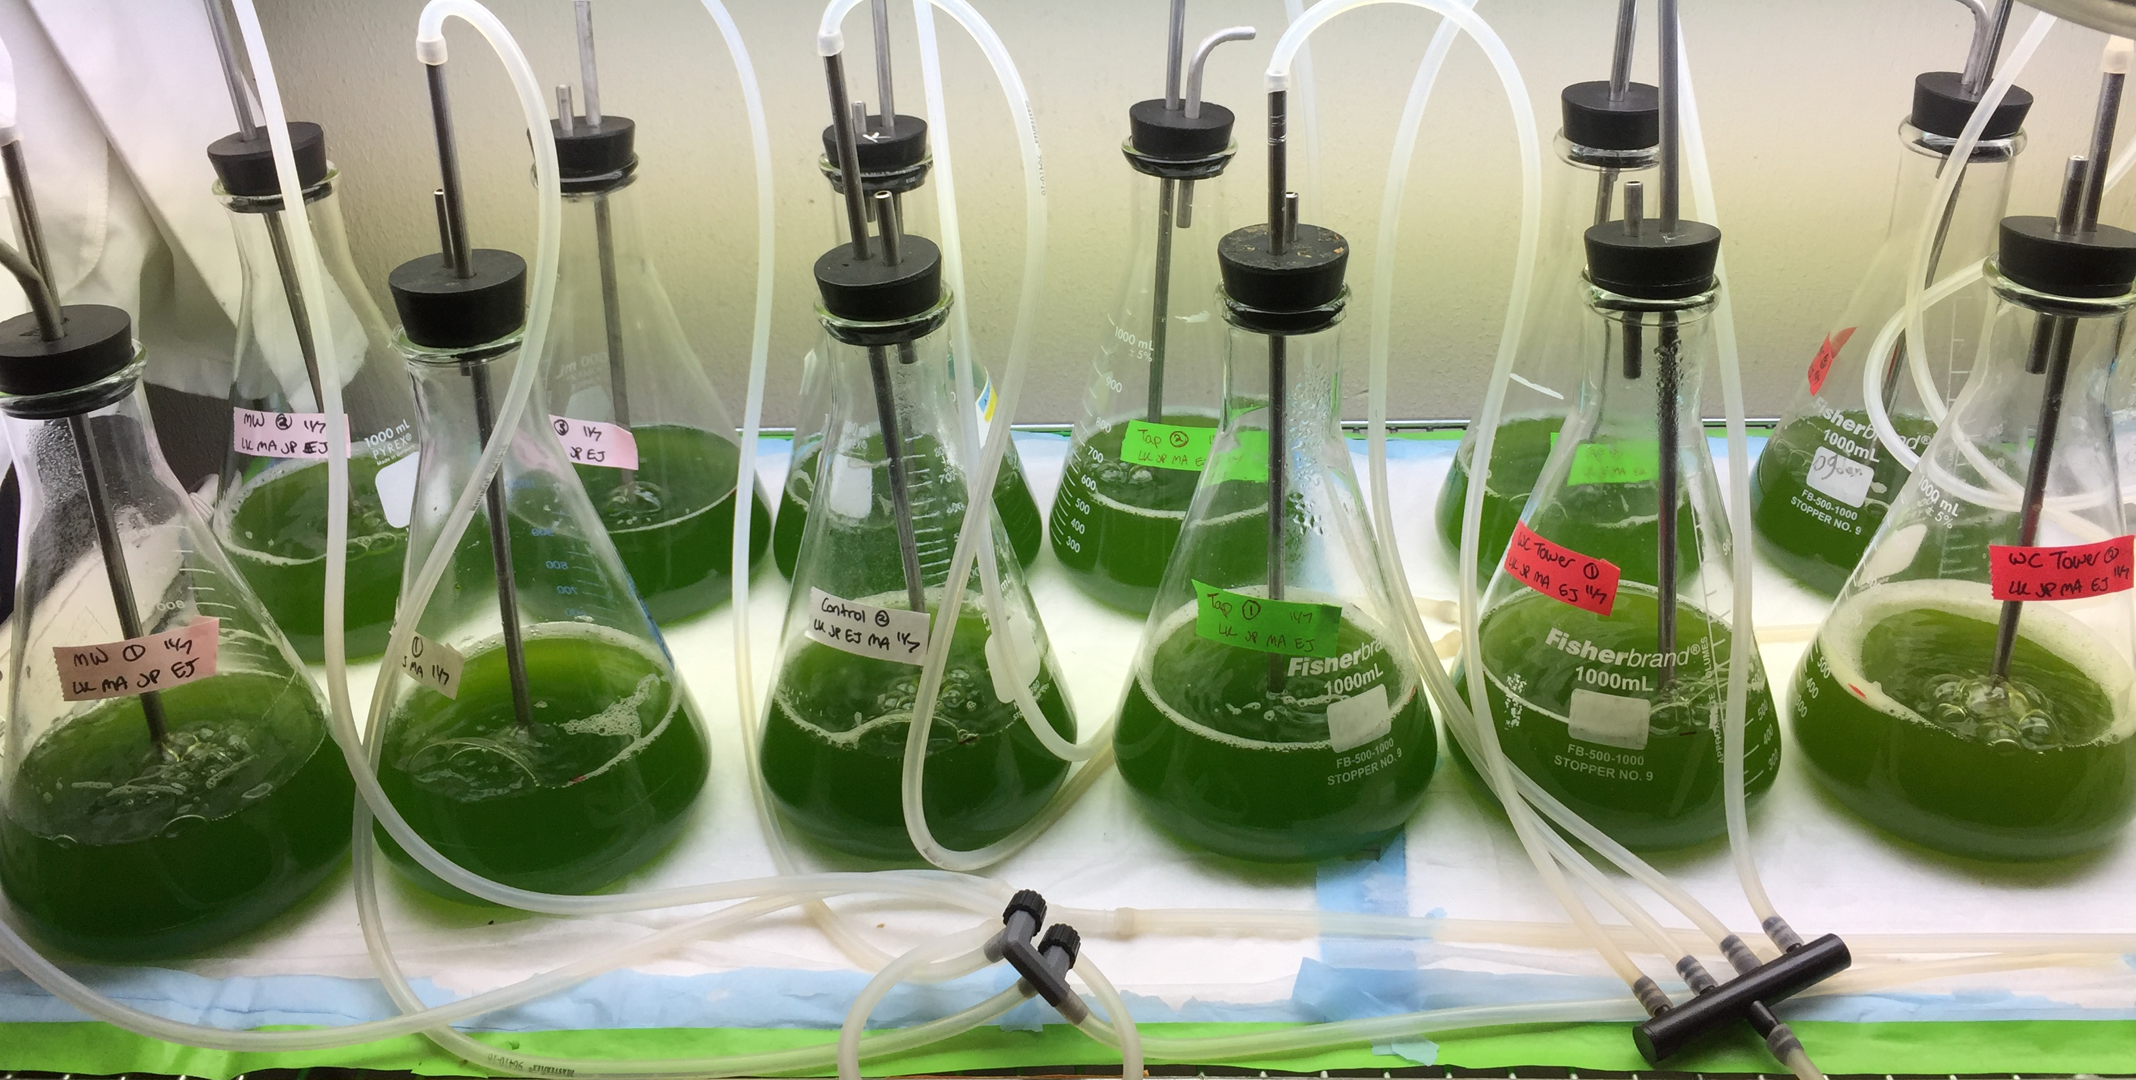
Process 2: Utilizing power plant wastewater
5/13
Another use for algae is to treat wastewater
Objective: analyze the growth rate of algae in different types of water
Samples taken from sites around the power plant:
  Cooling Tower water
  Makeup/recycle water
  Tap water
  Control (Distilled Water)

Slide 8
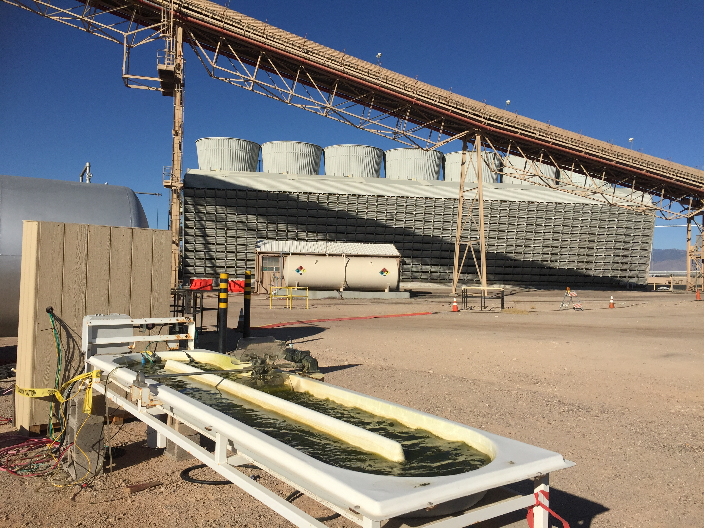
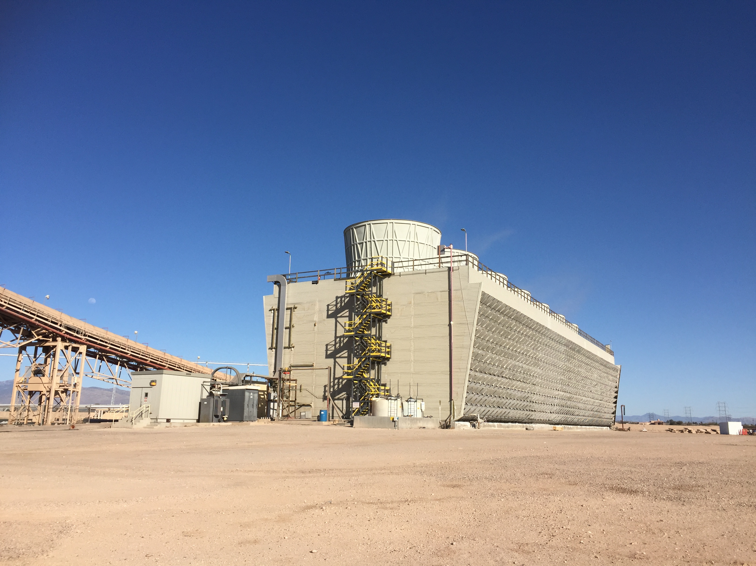
7/13
Water Cooling Tower
Overall System

Slide 9
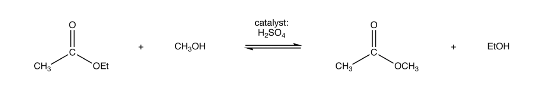
Analysis of the Biomass
8/13
Optical Density (OD)
  Measured daily at about the same time with an Infrared Spectrometer to show the algae growth rate in the raceway
Transesterification reaction
Ash Free Dry Weight
  Measurement of the organic material, determines percent of OD contributed to the algae versus water
Lipid extraction
Analysis by GC-MS/FID

Slide 10
9/13
Cooling Tower Water produced the best growth rate results

Slide 11
10/13

Slide 12
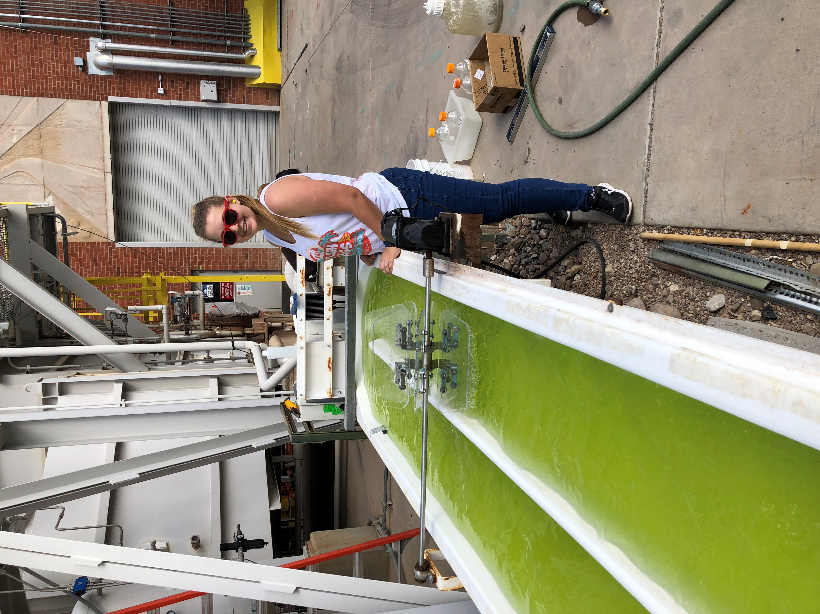
Conclusion and Future Prospects
11/13
Cooling Tower Water produced the best growth rate
The control produced the highest lipid content
Next step would be to take it out of the lab and pilot scale the experiment
Future research: water analysis
Other possible uses:
  Space operations
  Utilized in other types of power plants
  Fuel for jets, cars, and other transportation vehicles
  Inks
  Livestock feed

Slide 13
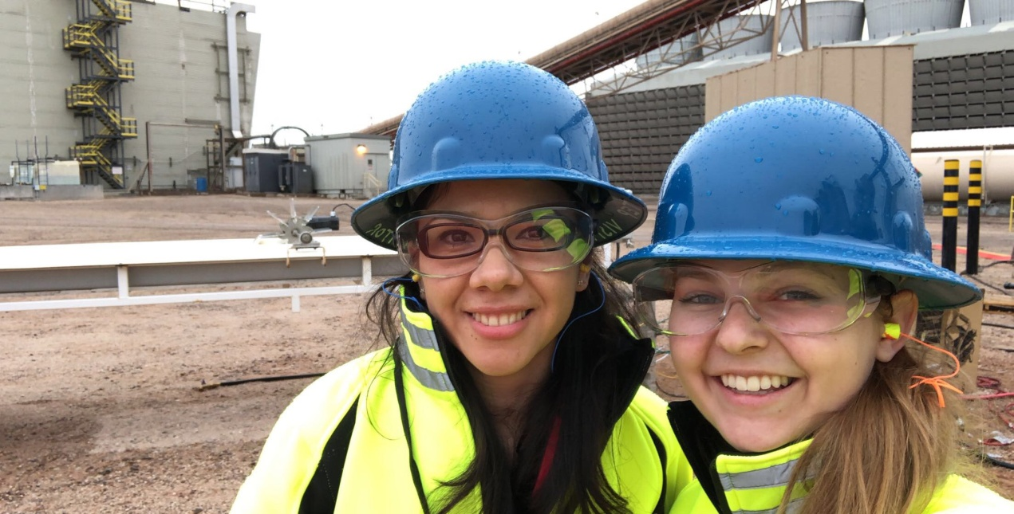
Special Thanks to:
12/13
Margarita Acedo
Dr. Kimberly Ogden
Esteban Jimenez
Leah Kaplan
NASA Space Grant
University of Arizona
Algae

Slide 14
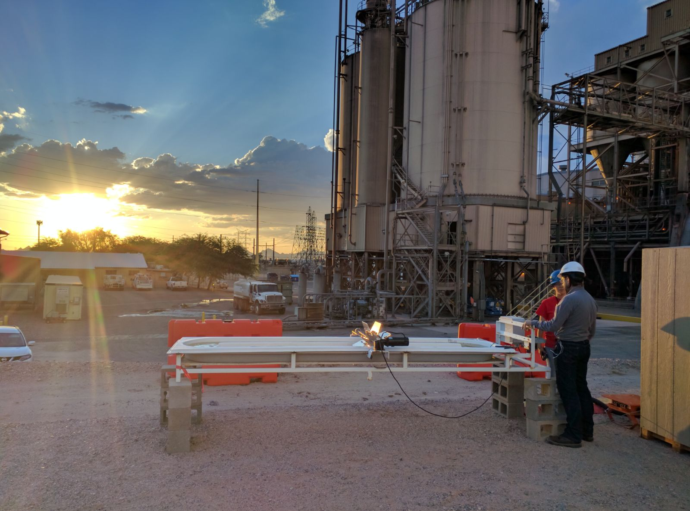
13/13
Thank You

